Slide 1


Weekly Report NTUA 29/11/2019
George Bakas

Slide 2
Signal Extraction
Fitted number of QCD events in SR_{A}
Measured dist from data
QCD shape taken from Data (CR)
$$S\left(x_{reco}\right)=D\left(x_{reco}\right)−C_{bkg}^{yield}N_{QCD}^{fit}C_{QCD}^{shape}\left(x_{reco}\right)Q\left(x_{reco}\right)−B(x_{reco})$$
Fiducial Yield
Transfer factor from SR_{A} to SR
QCD shape correction factor
Subdominant bkg shape and contribution (MC)
Where x_{reco} is the respected variable of interest (ttbar mass,pt, rapidity, leading and subleading jetPt and |jetY|)
We deploy a simultaneous fit in 3 regions (0,1,2 btag) because we do not have a pure Control Region.
Our data CR is ttbar contaminated
$$D{\left(m^{t}\right)}^{(i)}=N_{tt}^{(i)}T^{(i)}\left(m^{t},k_{MassScale}, k_{MassResolution}\right)+N_{bkg}^{(i)}B\left(m^{t} \right)\left(1+k_{1}x\right)+N_{sub}^{(i)}O^{(i)}\left(m^{t}\right)$$
We assume that $N_{tt}^{(0)}={\left(1−e_{b}\right)}^{2}N_{tt}, N_{tt}^{(2)}=e_{b}^{2}N_{tt} and N_{tt}^{(1)}=2\left(1−e_{b}\right)e_{b}N_{tt}$ where e_{b} is the b tagging efficiency and N_{tt} is the total ttbar yield.

Slide 3
R_{yield} Calculation (Data)
2016
2017
2018

Slide 4
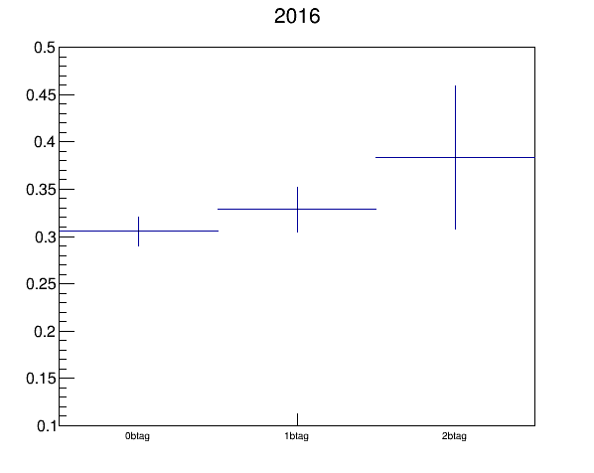
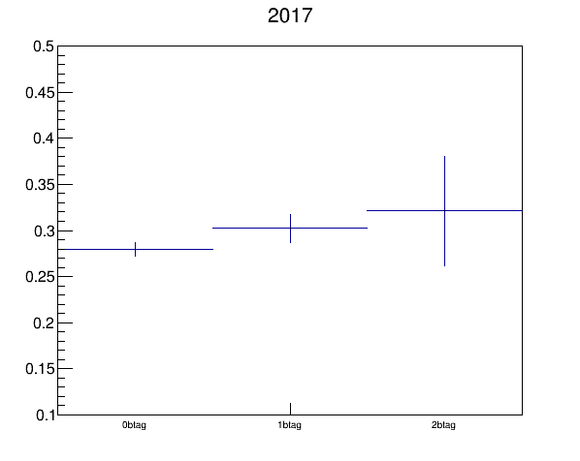
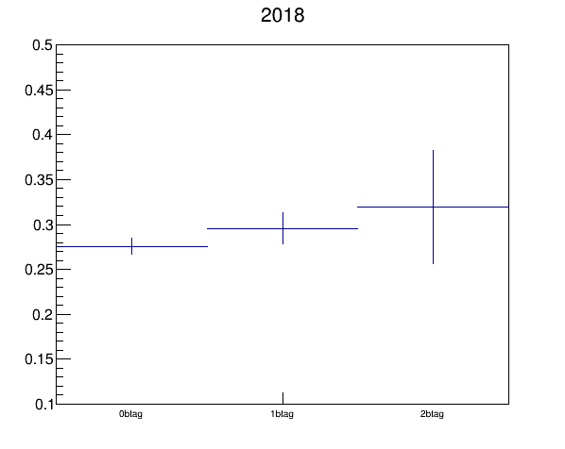
R_{yield} Calculation (MC Closure)
2016
2017
2018

Slide 5
NQCD (2) / NQCD (0) vs eb
2016
2017
2018
We define $R_{0}=\frac{D_{red}^{\left(0\right)}}{D_{ext}^{(0)}} and R_{1}=\frac{D_{red}^{\left(0\right)}−N_{TT,MC red}^{\left(0\right)}}{D_{ext}^{\left(0\right)}−N_{TT,MC ext}^{\left(0\right)}}$ and NQCD in Reduced SR $N_{QCD,red}^{(2)}= \frac{N_{fit,ext}^{(2)} }{N_{fit,red}^{(2)}}∗N_{QCDext}^{0} whereN_{QCDext}^{0}=D_{red}^{0}−TT_{MC, red}^{(0)}$
----2016----
R0 (just data) = 0.264097
R1 (taking MC into account) = 0.262092
(R[0]-R[1])/R[0] = 0.00759071
NQCD in Reduced (SR): 846.365
----2017----
R0 (just data) = 0.270622
R1 (taking MC into account) = 0.269242
(R[0]-R[1])/R[0] = 0.00509682
NQCD in Reduced (SR): 677.041
----2018----
R0 (just data) = 0.266928
R1 (taking MC into account) = 0.265428
(R[0]-R[1])/R[0] = 0.00561997
NQCD in Reduced (SR): 1201.35

